Slide 1
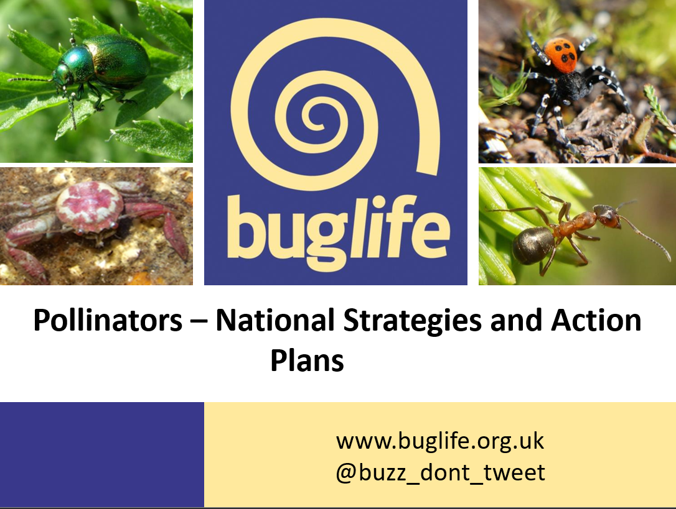
Surrey B-Lines & Haslemere
Louis Harrington-Edmans - Space4Nature Conservation Officer
Pollinators – National Strategies and Action Plans

Slide 2
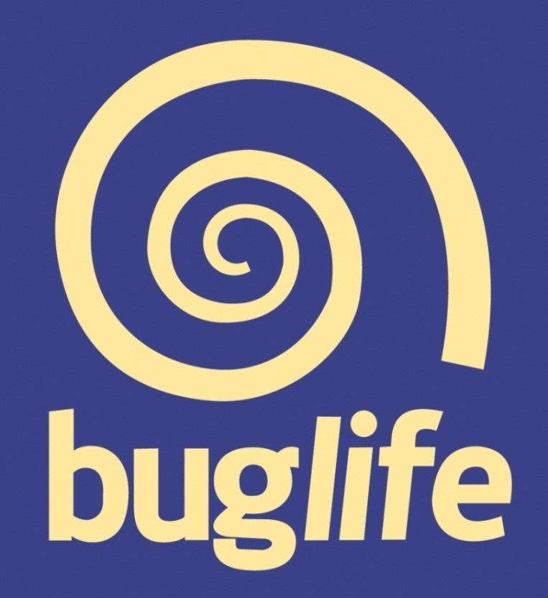
Buglife - The Invertebrate Conservation Trust
Saving the small things that run the planet

Slide 3
What Buglife’s aims?
Stop the extinction of invertebrate’s
and achieve sustainable populations of invertebrates.
  Room for invertebrates
  Safe for invertebrates
  Friendlier relationships with invertebrates

Slide 4
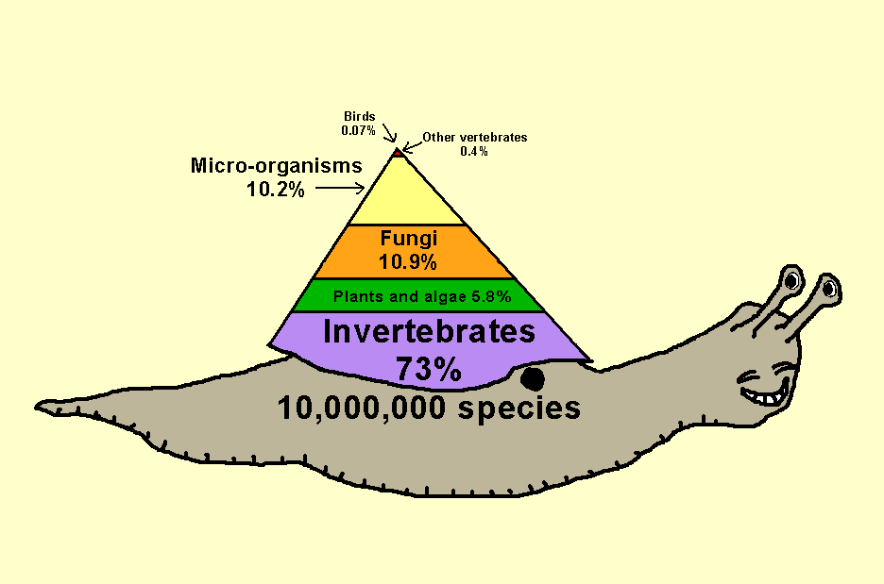
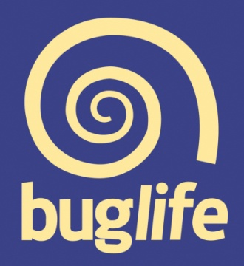
Community Assemblages
Notes:
Most diverse group
Often overlooked
Protect invertebrates (most) other things protected aswell

Slide 5
Importance of Invertebrates
98 % of Animal Species are Invertebrates

Slide 6
Overview of Invertebrates
There are over 40,000 invertebrate species in the UK, including:
~270 bees, ~9,000 wasps and ~40 ants
~7,000 flies, including ~280 hoverflies
59 butterflies and ~2,500 moths
~4,200 beetles, including 46 ladybirds
~2,000 true bugs
~650 spiders and ~30 harvestmen
37 woodlice
57 centipedes and 56 millipedes
>1,500 marine invertebrates
~200 snails, slugs and clams
27 earthworms

Slide 7
Physical Benefits to Humans
Ecosystem function (e.g. fisheries)
Soil quality (£16 billion of topsoil/year)
Medicinal benefits (leeches, horseshoe crabs, maggots, snail slime, jellyfish)
Pollination (90% of crop species, £691 million p/a)
Pest control (£32 million of beneficial insects sold/year)
Materials science (silk £2.7 billion/year)
Products
Nutrition (27.7 million tons/year) (UK – 2015 shellfisheries value = £275 million)
Tourism (coral reefs, butterflies and birds)
Environmental Quality Assessment (e.g. rivers)

Slide 8
Insect pollination and our ecosystems
Insect pollination is essential to maintaining a healthy and thriving environment
80% of British wild plants are pollinated by insects
62% of wildflowers pollination limited
1/3 mouthfuls of food insect pollination reliant
Thick legged flower beetle (Oedomera nobilis)

Slide 9
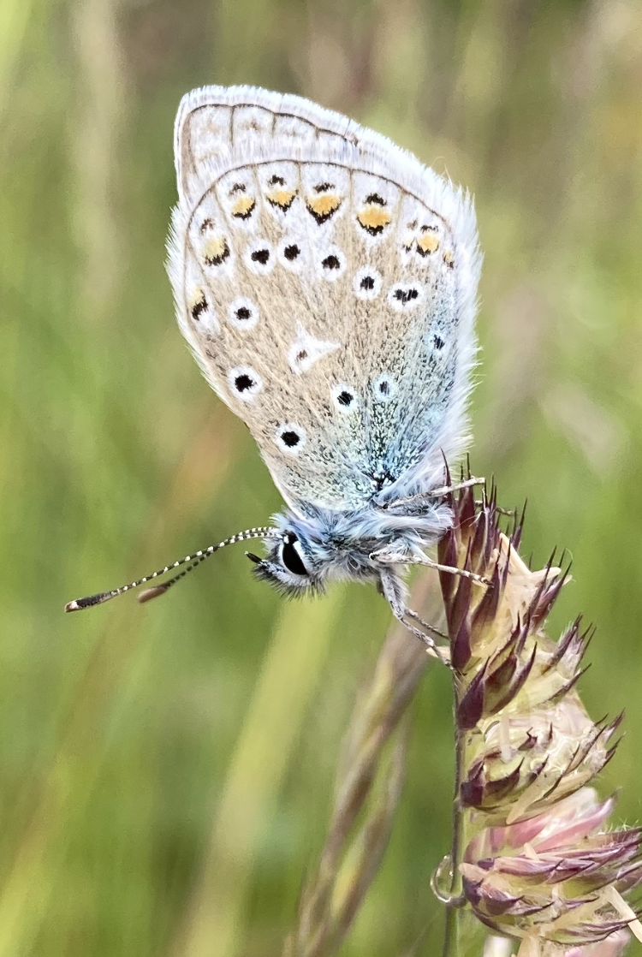
Aesthetic Benefits to Humans
Pleasure
Inspiration
Learning
Connection to the environment
Self worth (altruism)
Intrinsic Value
  All life valuable
  Human lead extinction wrong
  Cannot assess future riches provide
© Louis Harrington-Edmans

Slide 10
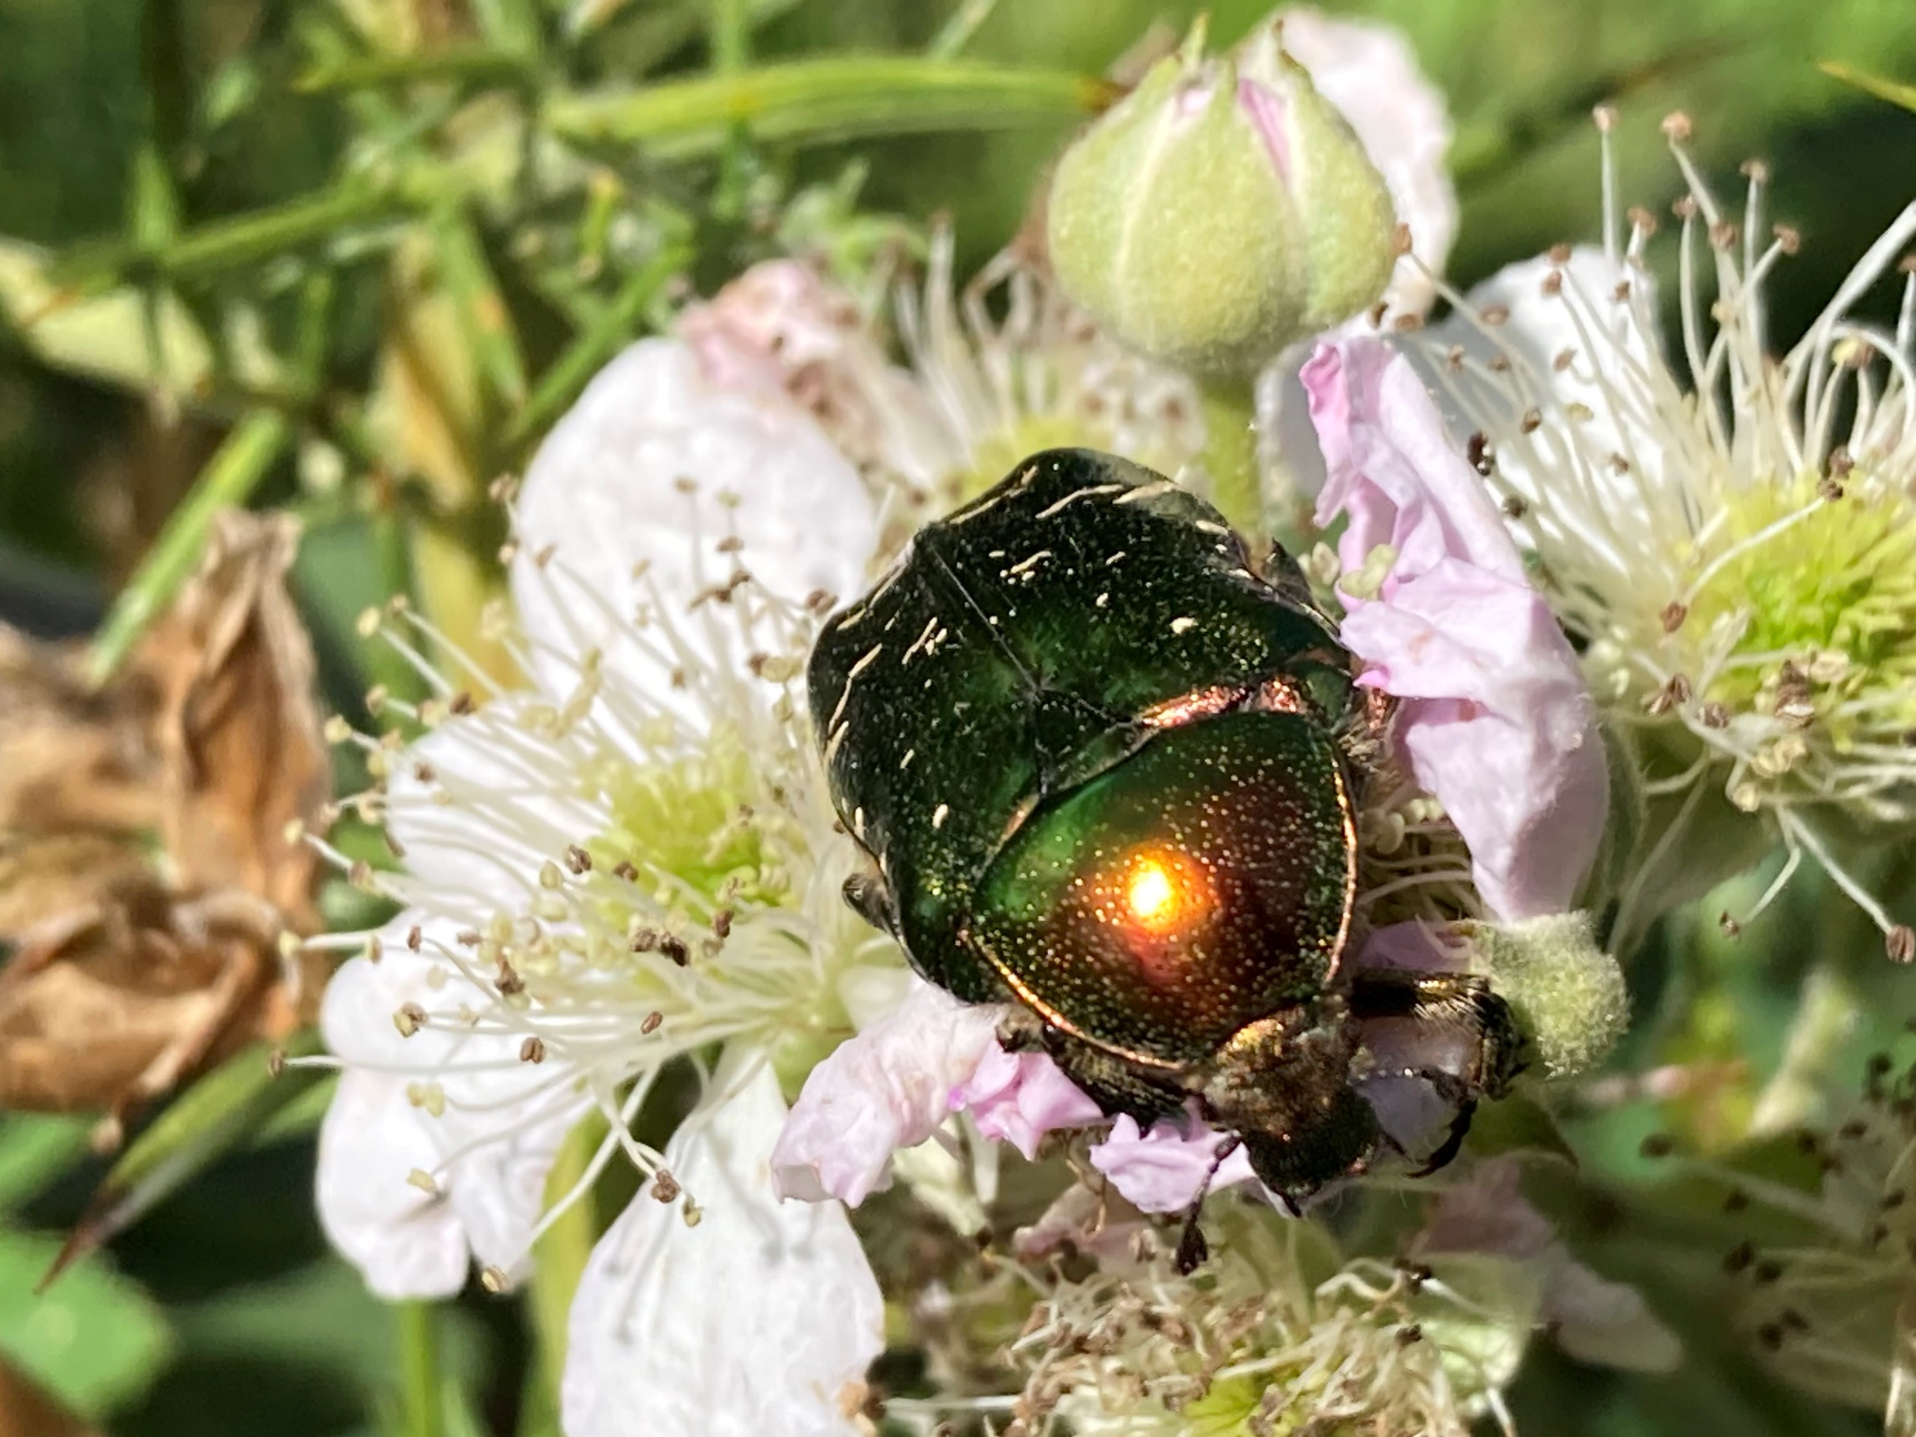
Rose Chaffer – Yateley Common
© Louis Harrington-Edmans

Slide 11
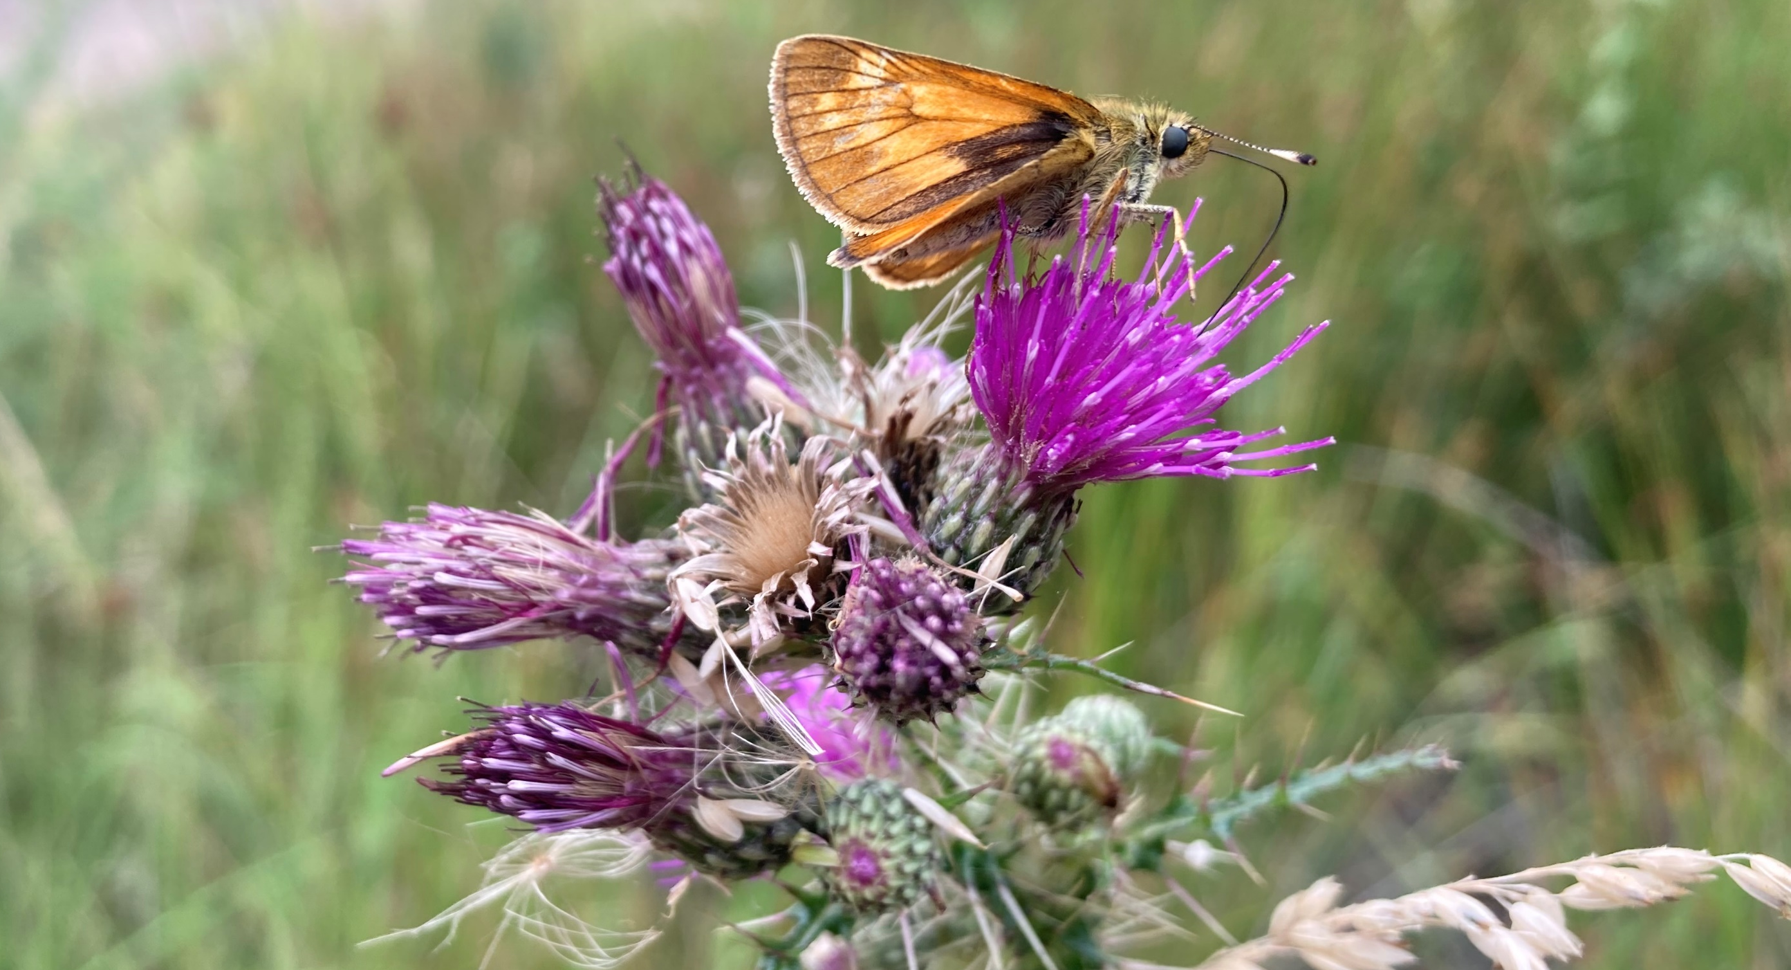
Large Skipper – Barossa
© Louis Harrington-Edmans

Slide 12
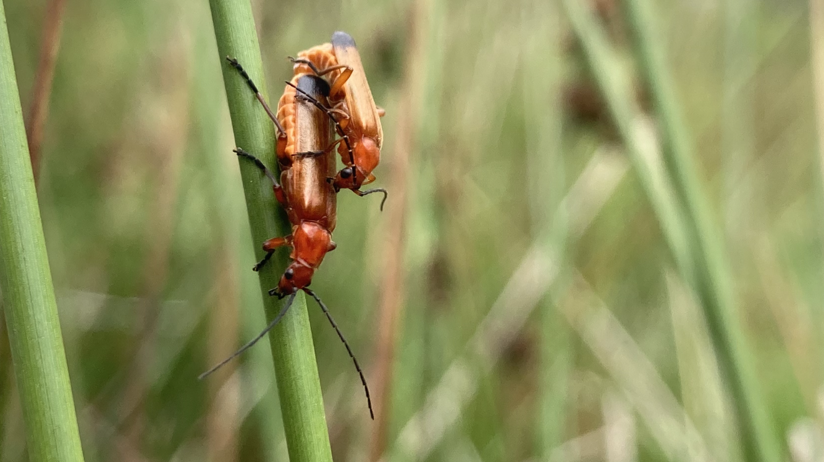
Red-Soldier Beetles – Wisley Common
© Louis Harrington-Edmans

Slide 13
Green-Eyed Flower Bee
© Michael Jones

Slide 14
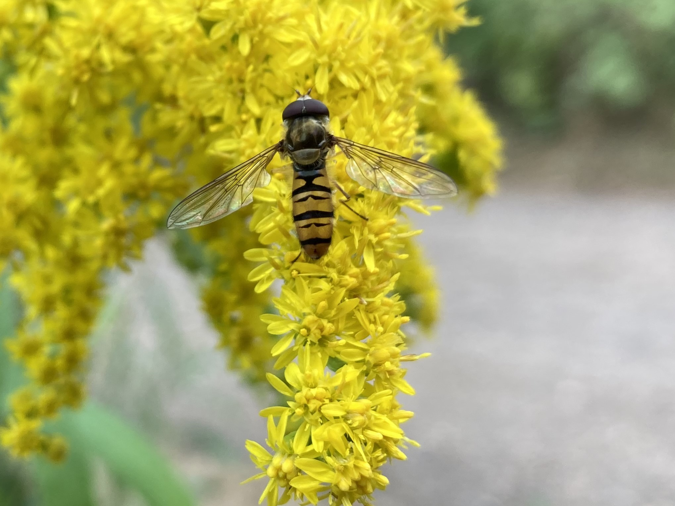
Marmalade Hoverfly – Bisley Common
© Louis Harrington-Edmans

Slide 15
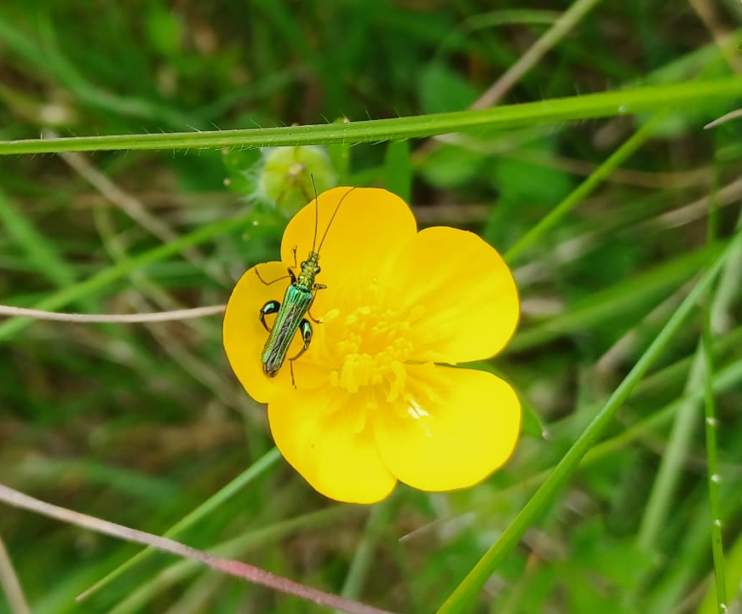
Swollen-Thighed Flower Beetle – Hogsback
© Louis Harrington-Edmans

Slide 16
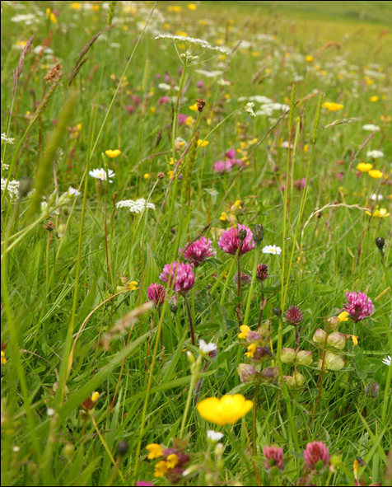
Invertebrates Under Threat
Climate Change
Pesticide/fertiliser use
Artificial light pollution
Competition with domestic honeybees & invasives
Habitat Loss and Fragmentation
Lost 97% of species rich-wildflower habitat (3 million ha) since 1930’s.
Fragmentation of remaining natural habitats

Slide 17
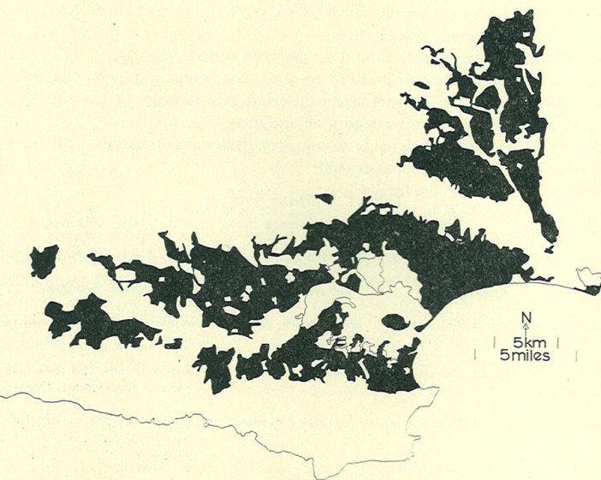
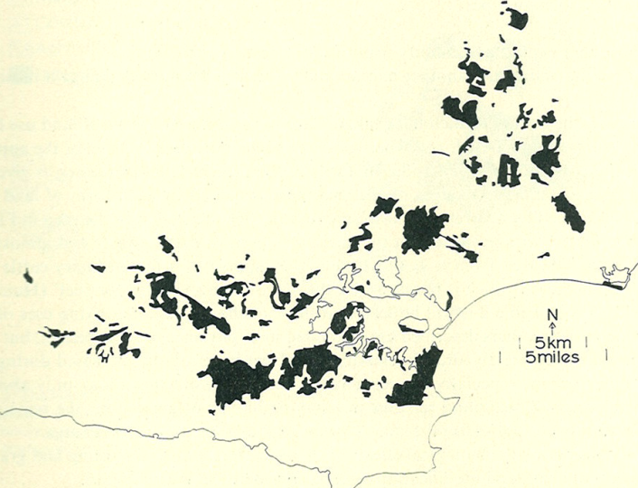
Habitat Loss & Fragmentation
1811
1960
Dorset Heaths.

Slide 18
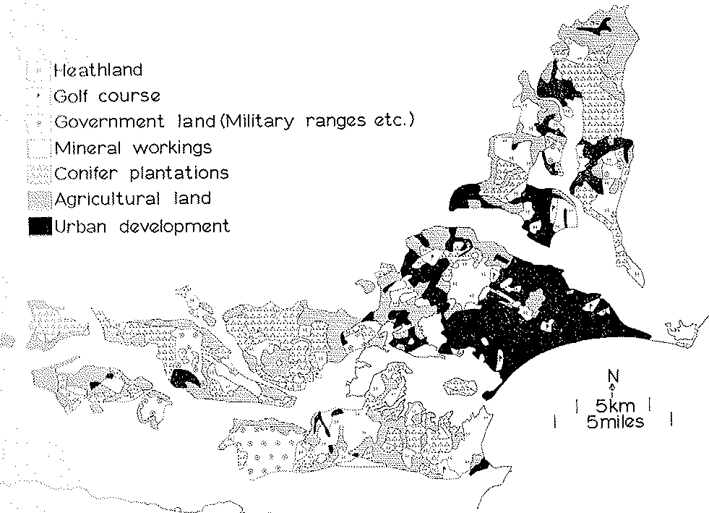
Habitat Loss & Fragmentation
1960

Slide 19
Marsh Fritillary
© Matt Shardlow
© Roger Key
Notes:
Large area low Grazing, extreme weather, abundant devil’s-bit scabious, parasitic wasp
Massive 20th century decline
100m dispersal from emergence
Unnaturally stable – conservation pursuit
^ requires indepth knowledge of complicated life history

Slide 20
The Result - Extinctions
1260 UK invertebrates extinct (100y) (EN data)
250 UK beetles undocumented 1970’s
12% of Surrey invertebrates locally extinct
  1970-2013 Surrey State of Nature Report

Slide 21
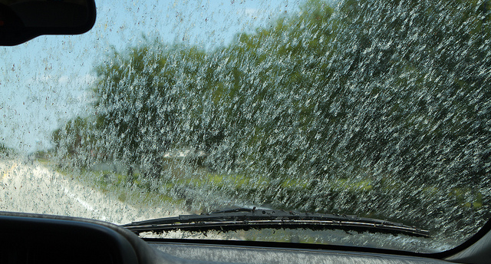

Slide 22
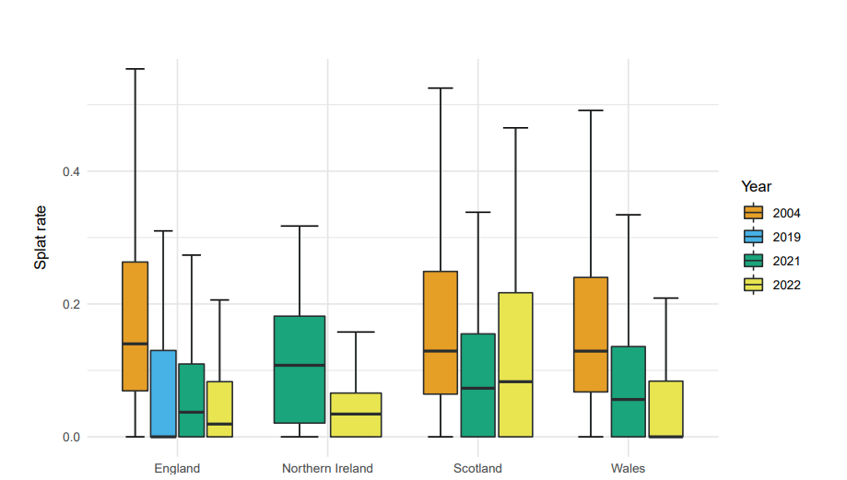
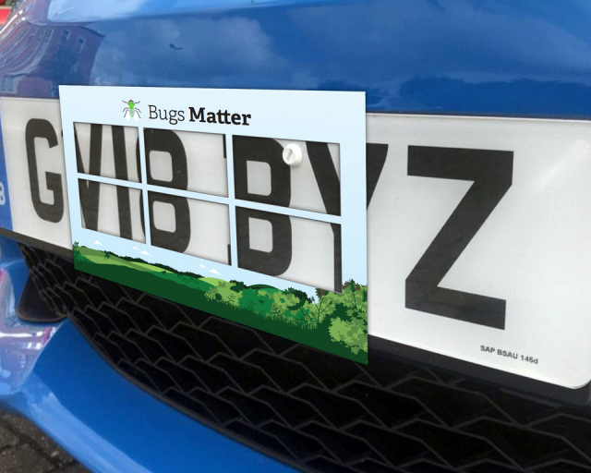
Bugs Matter
2004-2022 Splat rates
England - 67.5%
Wales – 74.8%
Scotland – 40.3%
NI – N/A
2021-2022 Splat rates
England – 16.1%
Wales – 43.9%
Scotland – 16% (increase)
NI – 45.5%

Slide 23
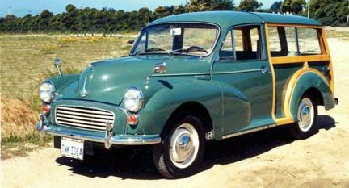

Slide 24

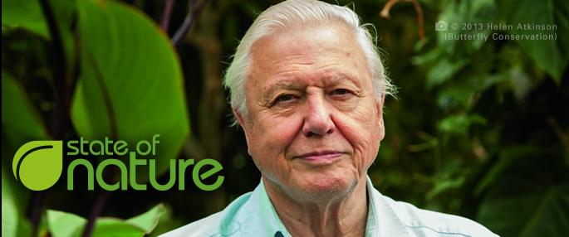
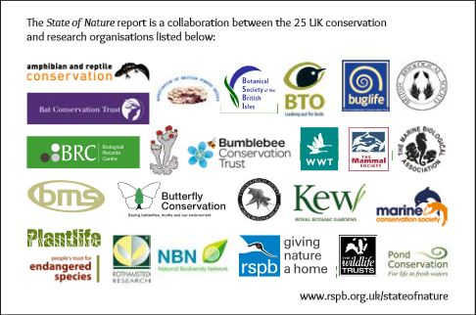

59% of invertebrates are in decline

Slide 25
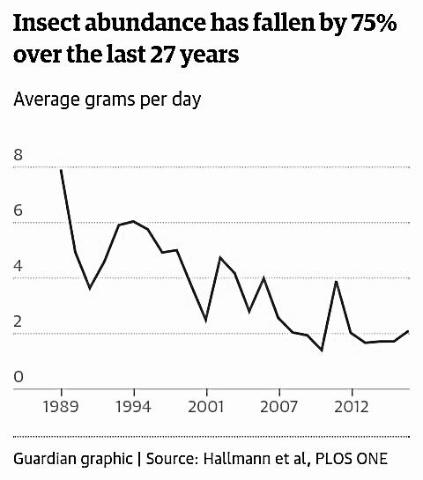
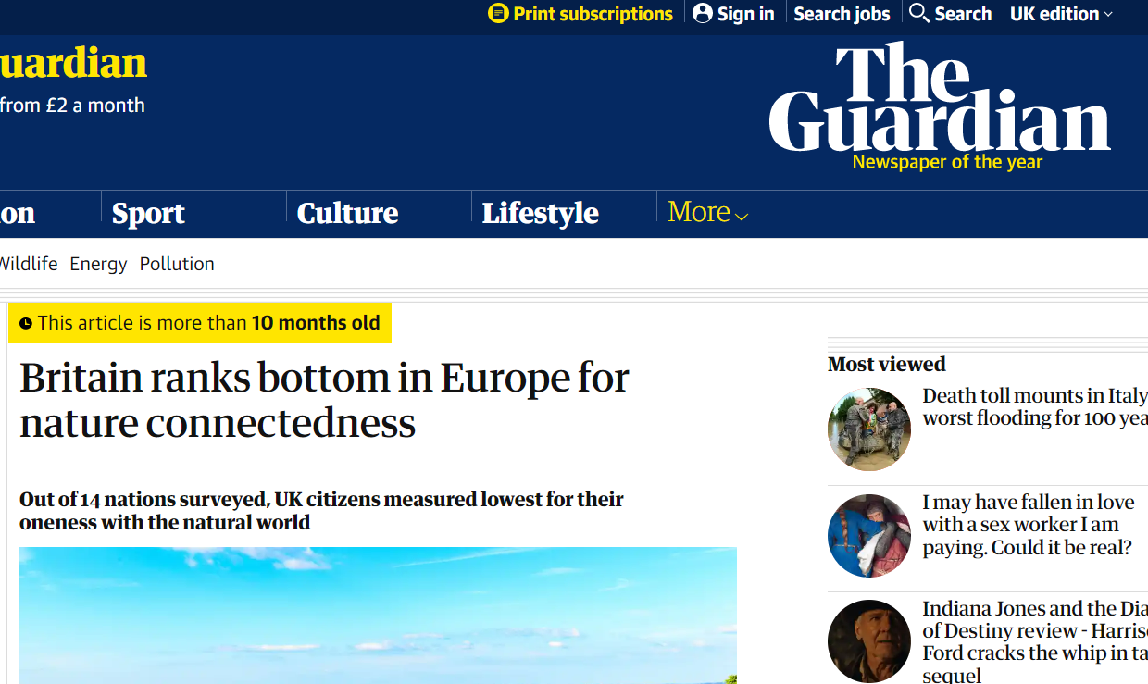
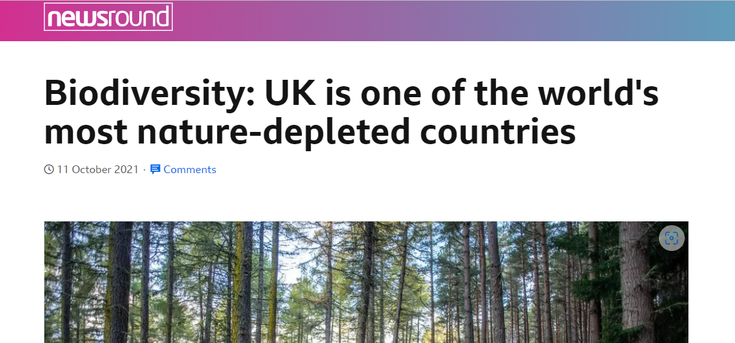
Hallmann CA, Sorg M, Jongejans E, Siepel H, Hofland N, Schwan H, et al. (2017) More than 75 percent decline over 27 years in total flying insect biomass in protected areas. PLoS ONE12(10): e0185809. https://doi.org/10.1371/journal.pone.0185809

Slide 26
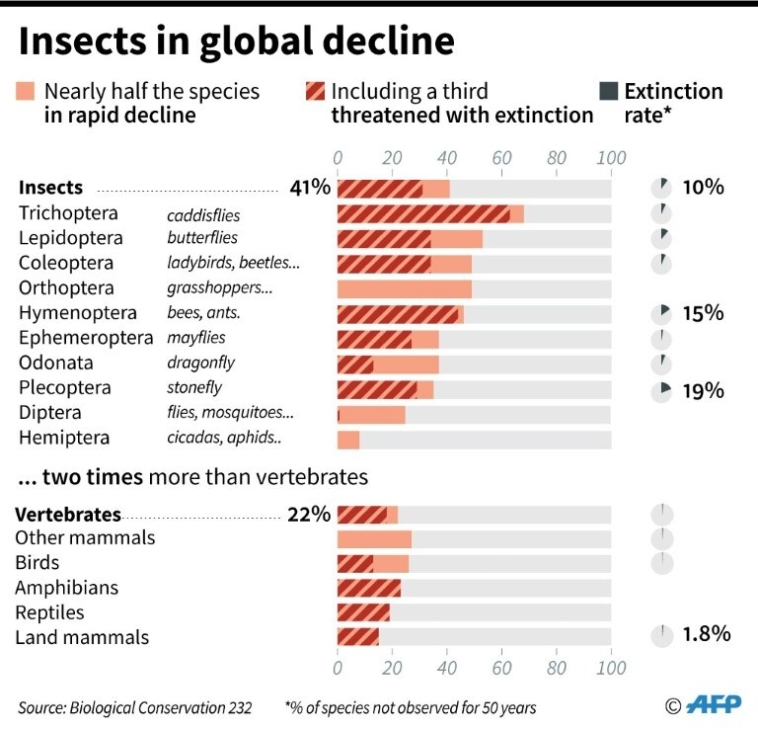

Slide 27
Butterfly data contributes to extinction debate
2000 Atlas data very through –
20,000 recorders + 15,000,000 records
over previous 40 years
71% of butterflies had declined¹
More recently (2011)
72% decreased in abundance over 10 years
76% decreased in distribution or abundance²
1 Comparative Losses of British Butterflies, Birds, and Plants and the Global Extinction Crisis J. A. Thomas, M. G. Telfer, D. B. Roy, C. D. Preston, J. J. D. Greenwood, J. Asher, R. Fox, R. T. Clarke, and J. H. Lawton Science 19 March 2004: 1879-1881.
2 Fox, R., Brereton, T.M., Asher, J., Botham, M.S., Middlebrook, I.,Roy, D.B. and Warren, M.S. 2011. The State of the UK's Butterflies 2011. Butterfly Conservation and the Centre for Ecology & Hydrology, Wareham, Dorset.

Slide 28
Butterfly data contributes to extinction debate
In comparison:-
54% of birds have declined
28% of plants have declined
33% fewer butterflies than 10 years ago
SSSIs failing to protect populations
Butterflies (Defra and Butterfly Conservation)
Therefore it seems likely that invertebrates are bearing the brunt of the extinction crisis

Slide 29
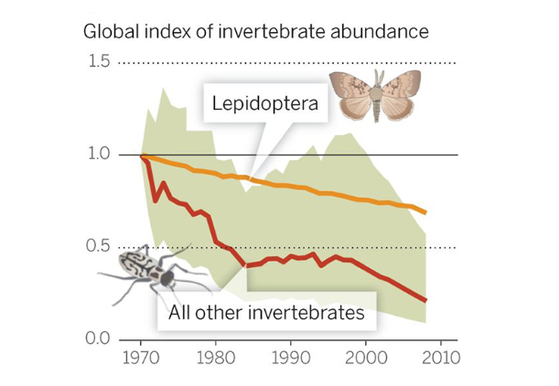
Geographic Scale
Based on: Dirzo et al 2014 Defaunation in the Anthropocene. Science 25 Jul 2014:

Slide 30
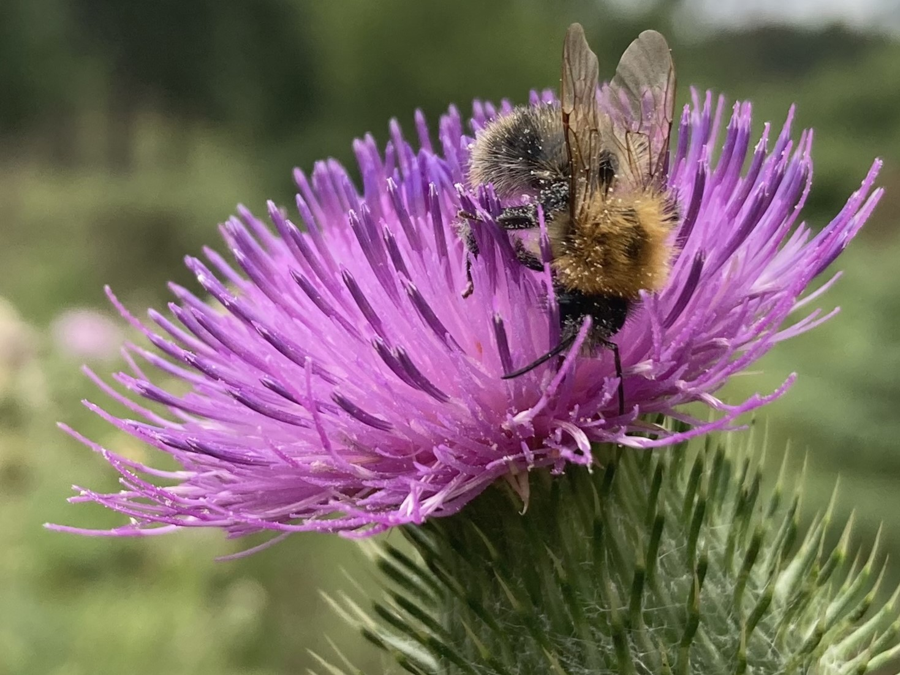
UK Bumblebee Trends
Six species declined in UK by at least 80% in last 50 years (Edwards pers. Comm)
  24 UK Bumblebee Species
Short-haired Bumblebee Bombus subterraneus extinct in early 1990s

Slide 31
Great Yellow Bumblebee
(Bombus distinguendus)

Slide 32
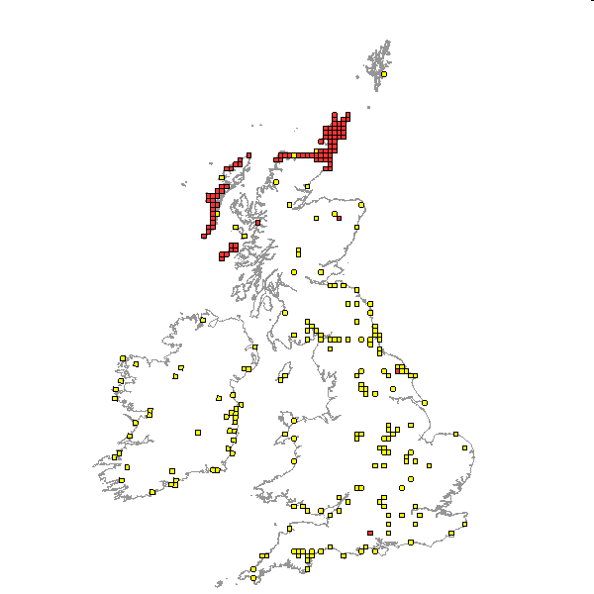
Great Yellow Bumblebee
(Bombus distinguendus)
Red squares = 1990 to present

Slide 33
Shrill Carder Bee (Bombus sylvarum) (a bumblebee!)

Slide 34
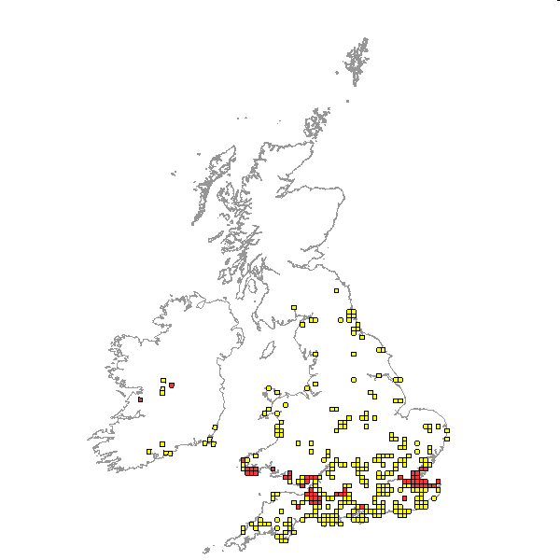
Shrill Carder Bee
(Bombus sylvarum)
Red squares = 1995 to present

Slide 35
Moth declines as well
In last 50 years 41% of species decreased in abundance and only 10% increased.
Fox R, Dennis EB, Harrower CA, Blumgart D, Bell JR, Cook P, Davis AM, Evans-Hill LJ, Haynes F, Hill D, Isaac NJB, Parsons MS, Pocock MJO, Prescott T, Randle Z, Shortall CR, Tordoff GM, Tuson D & Bourn NAD (2021) The State of Britain’s Larger Moths 2021. Butterfly Conservation, Rothamsted Research and UK Centre for Ecology & Hydrology, Wareham, Dorset, UK.

Slide 36
White-line Dart (Euxoa tritici) 94% decline in 40 years

Slide 37
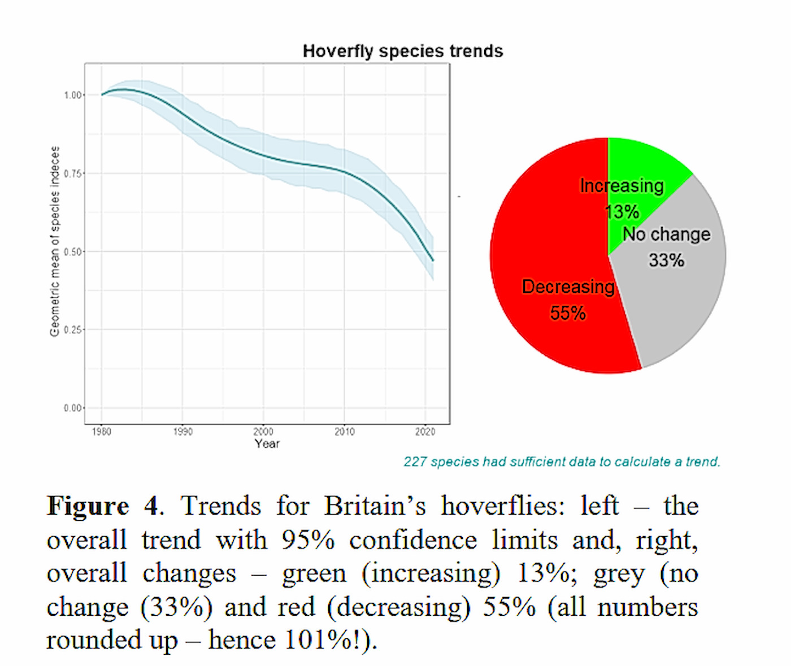
UK hoverfly species trends
Roger Morris Hoverfly Newsletter no. 71, Bulletin of the Dipterists Forum, Spring 2022

Slide 38
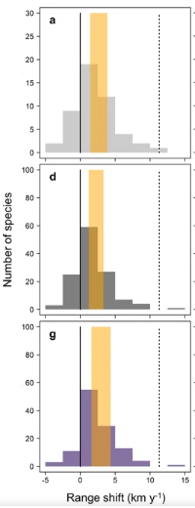
Invertebrates not keeping up with climate change due to habitat fragmentation.
Solid line = 1976–90 climate, dotted line = 2001–15 climate.
a = butterflies, dragonflies, grasshoppers & hoverflies,
d = 8 other groups,
G = Macromoths.
Platts, P. J., Mason, S. C., Palmer, G., Hill, J. K., Oliver, T. H., Powney, G. D., Fox, R. & Thomas, C. D. (2019) Habitat availability explains variation in climate-driven range shifts across multiple taxonomic groups. Scientific Reports volume 9, Article number: 15039

Slide 39
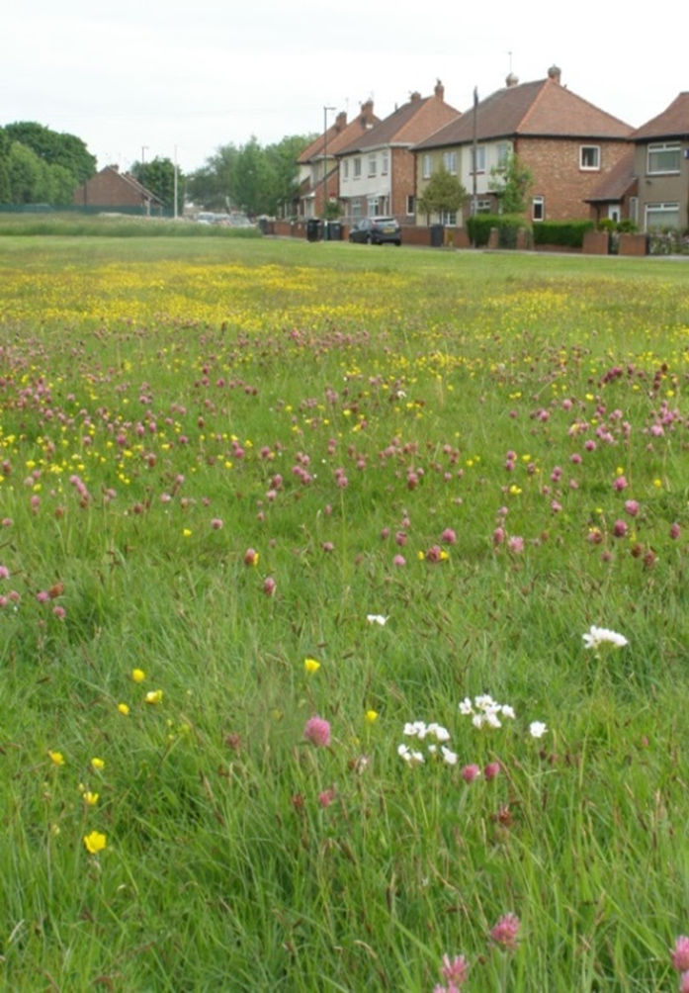
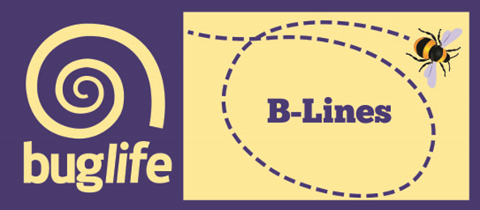
A UK-wide approach is needed to reverse declines in pollinators
Significantly more wildflower-rich habitats are needed
We need to create more ‘permanent’ habitat features
Fragmentation of our existing wildflower-rich areas needs to be reduced
We need to connect pollinator habitats across urban and rural environments
Our Solution: The B-Lines

Slide 40

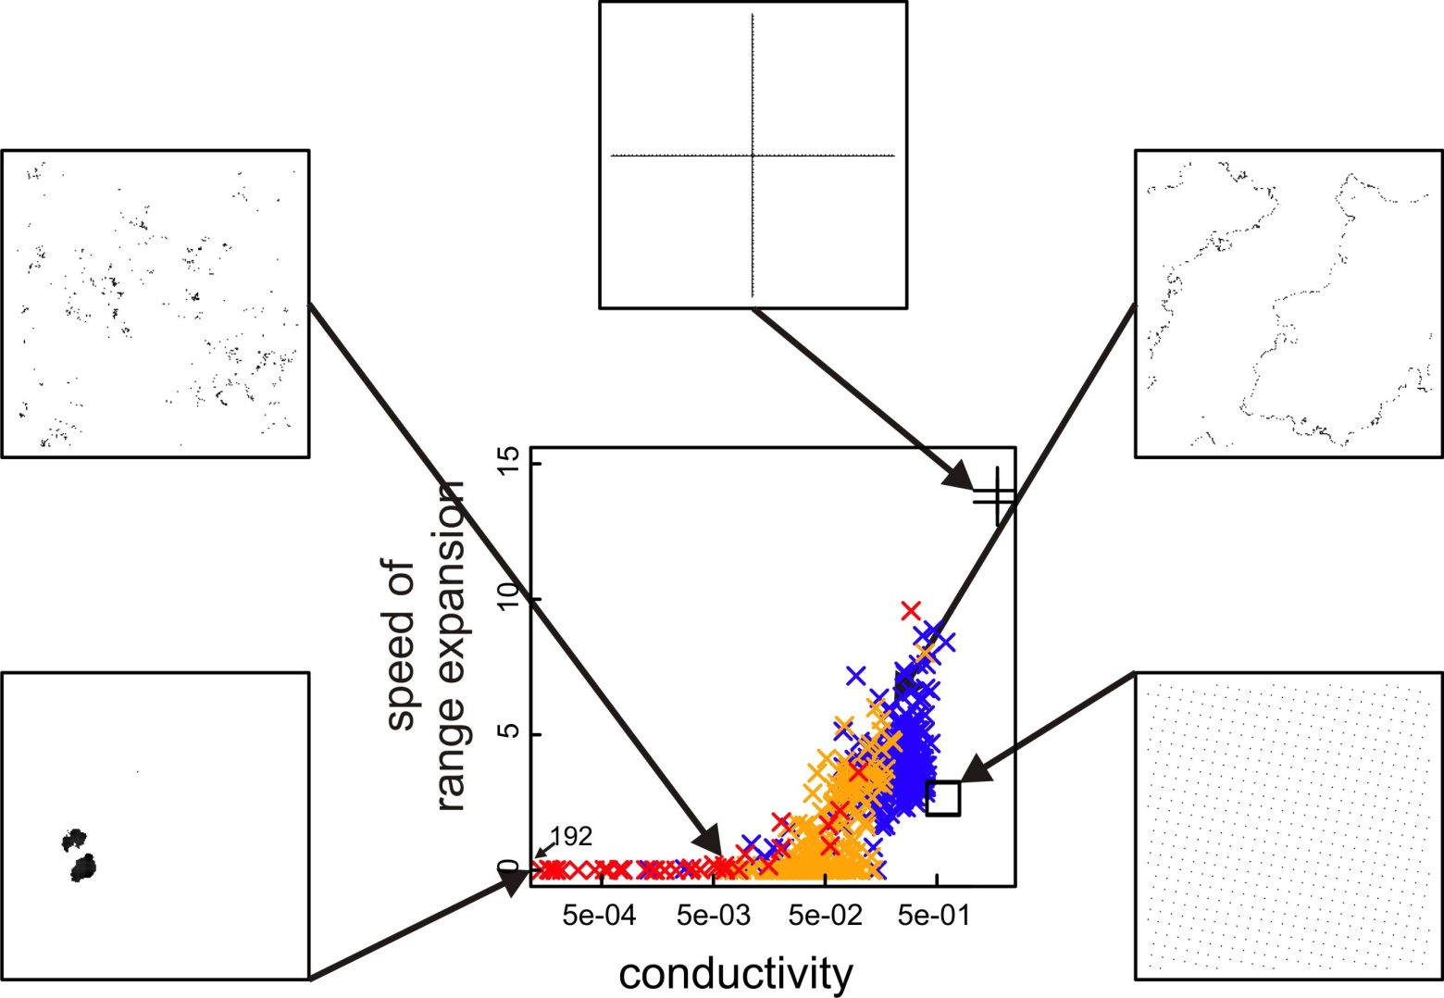
B-Lines: Our Solution
Notes:
Modelling carried out by Liverpool Uni at the beginning of B-Lines project showing the speed of range expansion of species within a imaginary scenario within different habitat distributions. This modelling is based on electrical currents of flow and paths of least resistance.
Each square has same amount of habitat in different array – natural and unnatural
Bottom left: Great in stable environment but provides little landscape movement
Top left: Natural with scattered patches, much like our landscape. Lots of movement but no rapid spread as they move randomly across patches but don’t colonise quickly.
Bottom right: works well as very connected but isn’t realistic
Top middle - In absence of being able to create straight lines – we have
Top right: B-Lines style- stepping stones between habitat lumps of habitat with rapid movement. Ability to move across a landscape

Slide 41
B-Lines: Our Solution
Mapping Methodology and Workshop
Notes:
Mapping carried out by Cumbria Biological Data Centre (developer of the ArcGIS B-Lines methodology)
Liaison with Bristol Environmental Records Centre
Data largely provided by Natural England, Avon Wildlife Trust, Council partners and BRERC
Mapping workshop attended by wide range of partners including LAs, NE, National Trust, BRERC

Slide 42
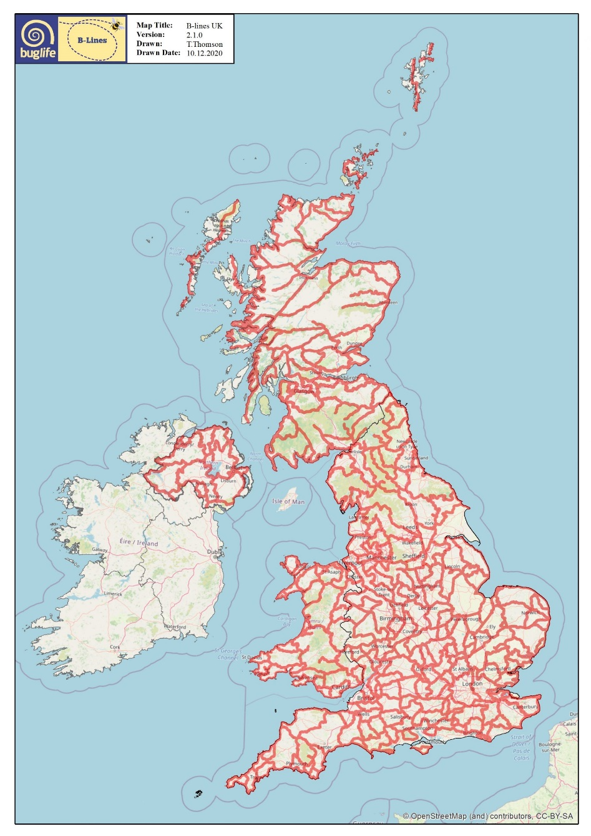

Slide 43
B-Lines
World’s largest/most joined connectivity project
3km wide continuous lines
  Linking best wildlife areas
Permanent wildflower-rich habitat
  150,000ha target
Co-ordinated approach
  5x greater efficiency
Collaborative approach
  Anyone can contribute
  Harnessed existing initiatives

Slide 44
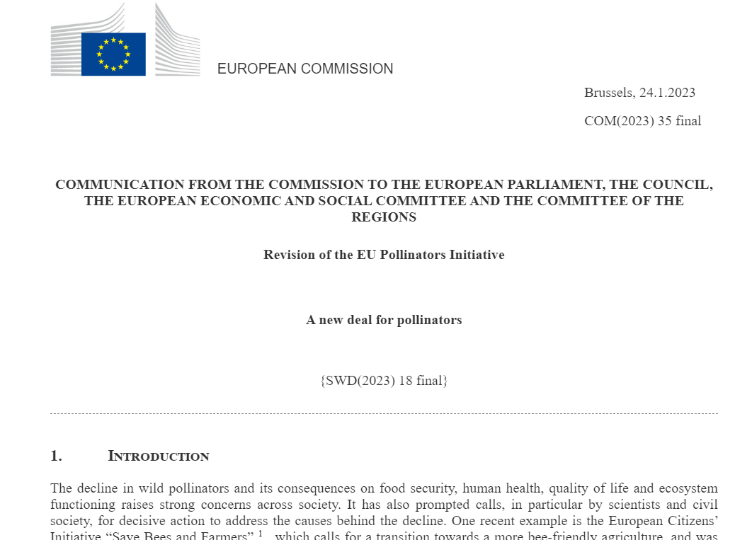
B-Line Guidelines
Buzzlines (B-Lines)
  2027
Pollinators in Protected Areas
  Existing PAs
  New PAs
Key Pollinator Areas (IIAs)
Pollution
  Light pollution
  Co-formulant
National Pollinator Strategies

Slide 45








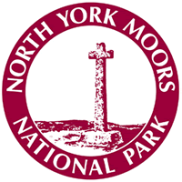

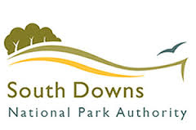


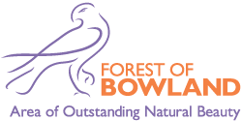


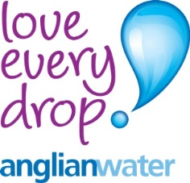


B-Lines – a partnership approach
Some of our partners
Notes:
Main funders – Cory Environmental Trust in Britain and Ibstock Cory Environmental Trust. Also Natural England, Wessex Water, Bristol City Council, B&NES, South Gloucestershire Council, February Foundation, D’oyly Carte Charitable Trust

Slide 46
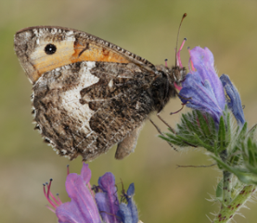
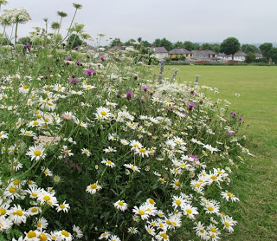
B-Lines – everyone can contribute
Everyone can get involved…..
Farmers
Councils
Conservation partners
Businesses
Communities
Schools
General public

Slide 47
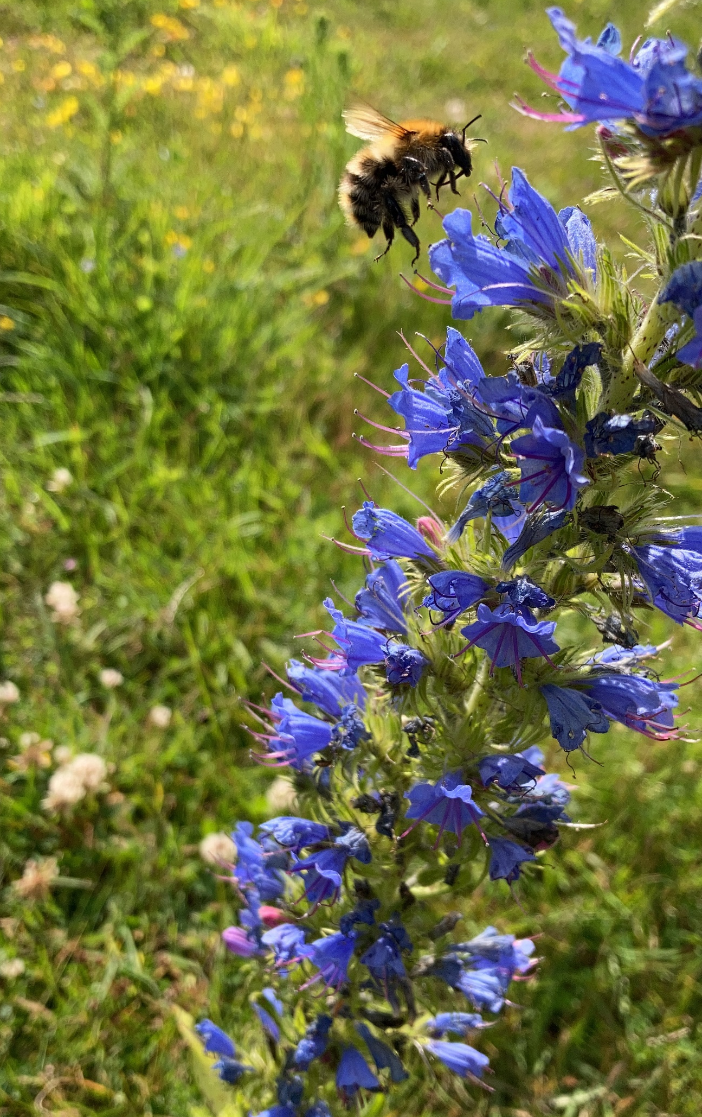
B-Line Guidelines
Wildflower-rich habitat
  Wildflower Meadows
  Heathland
Creation, restoration and enhancement
Site expansion or steppingstones
  >2ha
  0.3km gaps (0.5km)
Agrochemical free
10-year management commitment
© Louis Harrington-Edmans

Slide 48






Made possible by the players of:
Notes:
100,000£
30ha
3 years (from September)

Slide 49
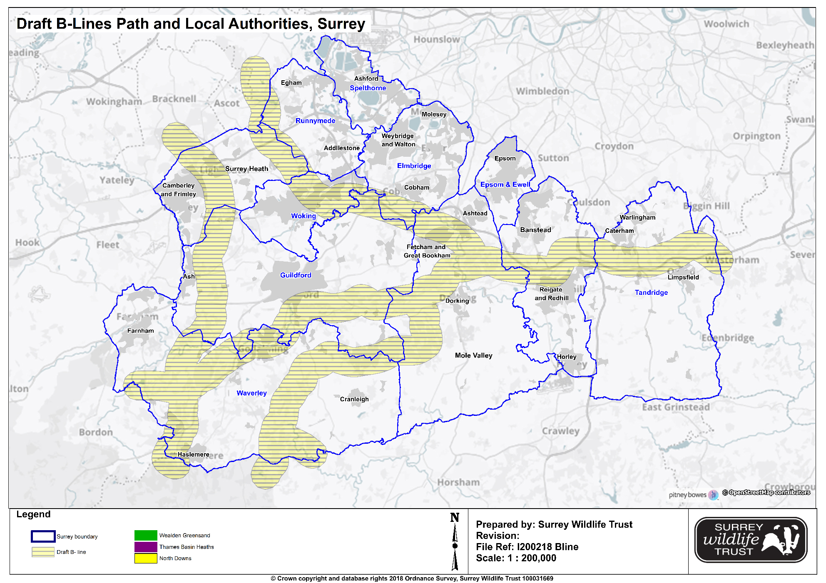
Surrey B-Lines Map
Notes:
Map completed in December 2014

Slide 50
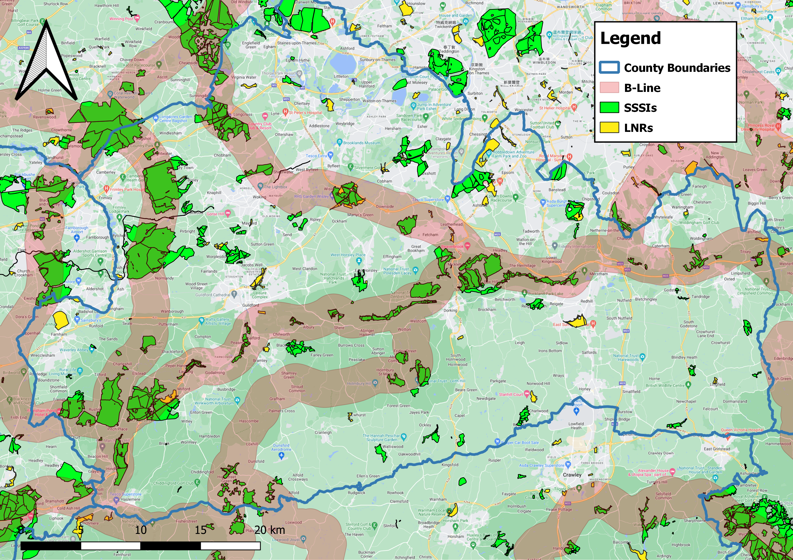

Slide 51
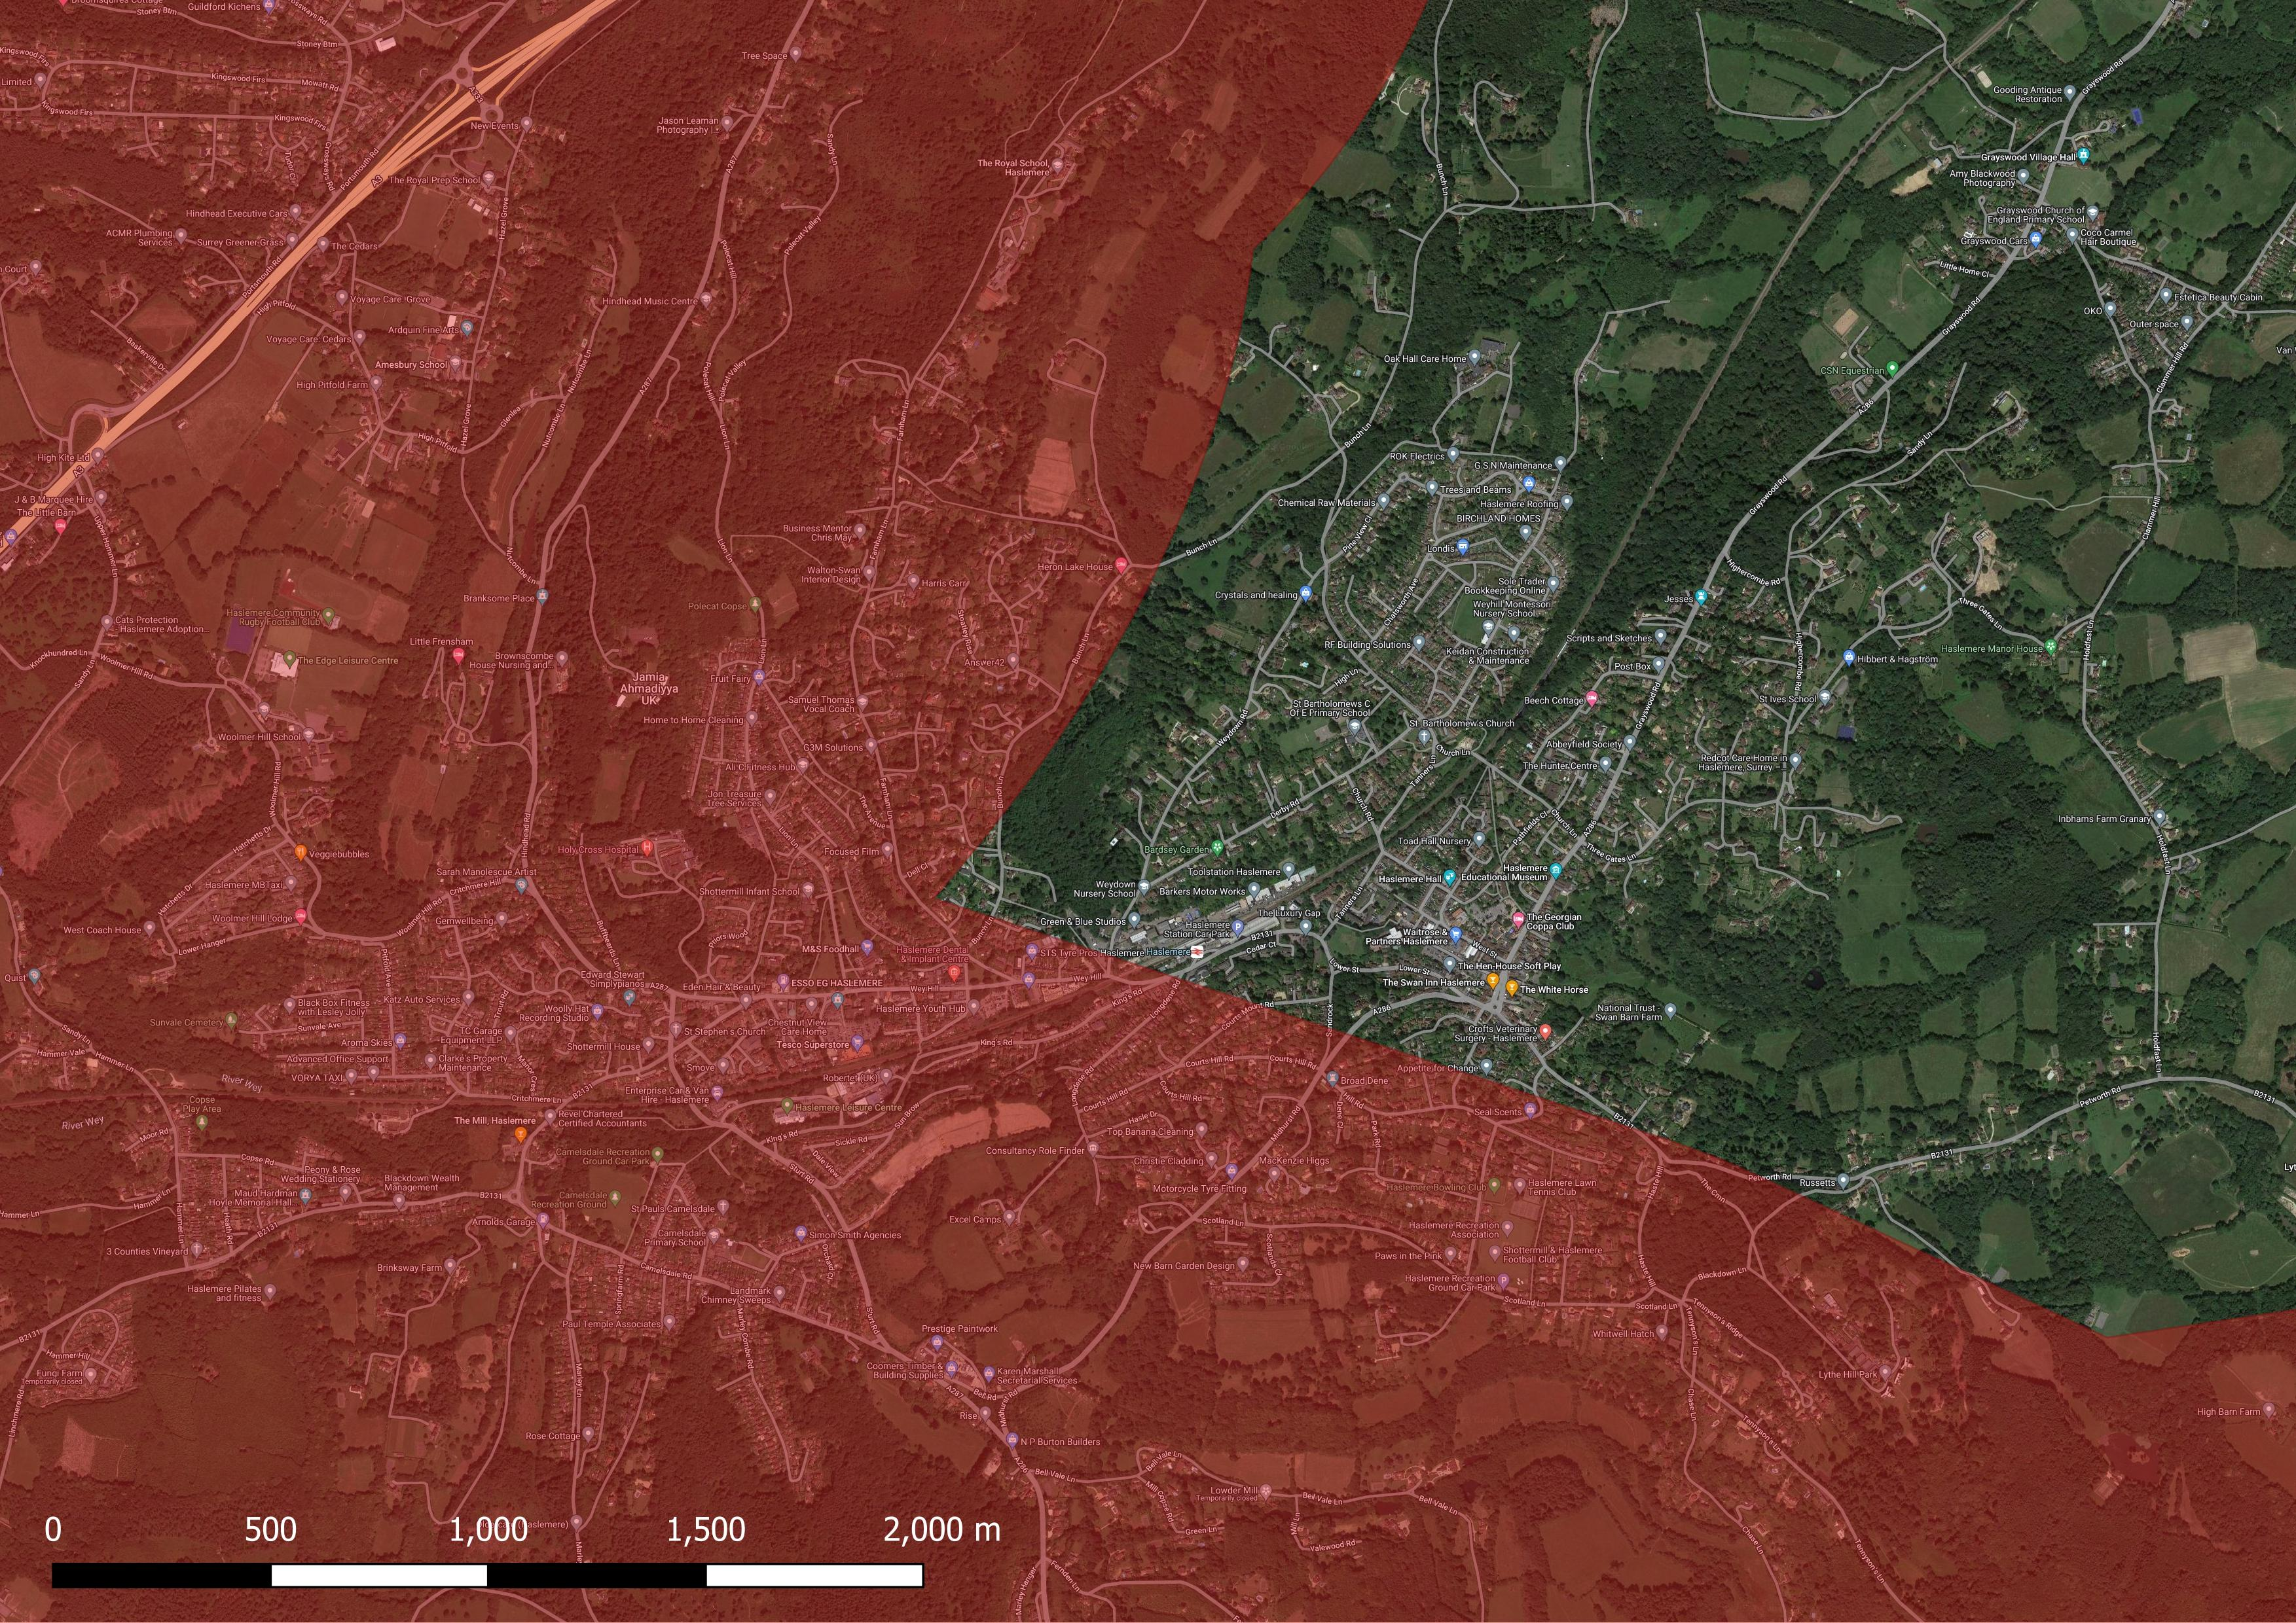
Notes:
Low weald BOA
Important Invertebrate Area

Slide 52
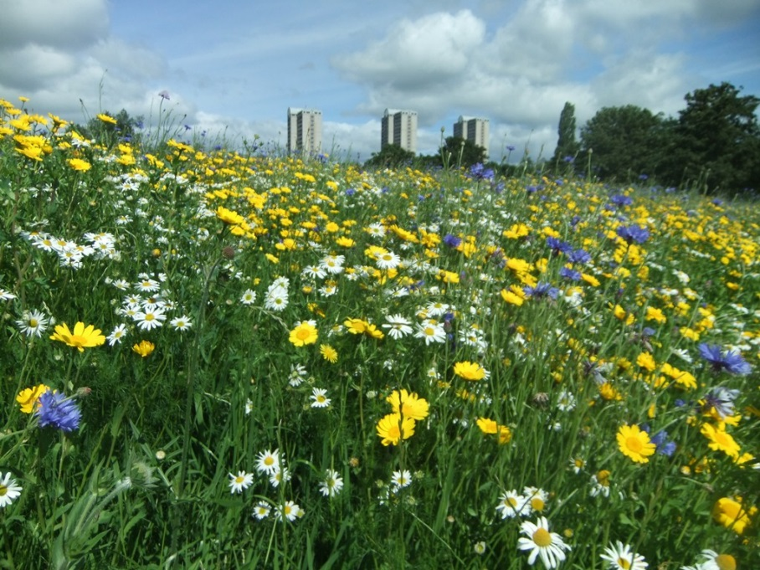
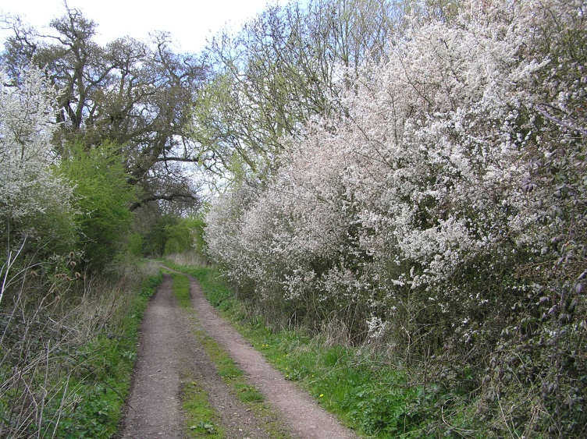
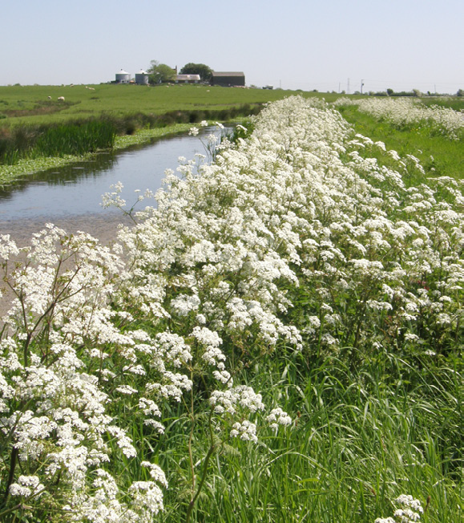
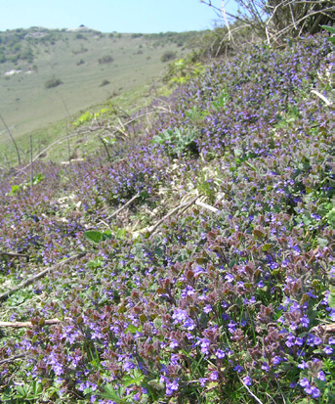
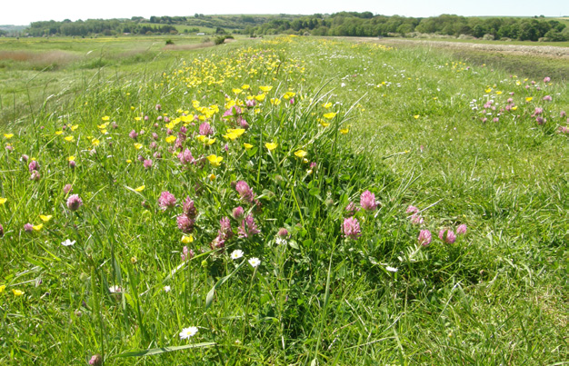
B-Lines: Restoring or adding new features

Slide 53

B-Lines : Restoring wildflower-rich habitats
Our initial priority is the restoration and expansion of existing wildflower-rich habitats

Slide 54



Slide 55



Slide 56


Slide 57


B-Lines: Creating new habitats
Need to create wildflower-rich habitats
    Replacing 97% lost
© Laura Larkin
© Laura Larkin
© Laura Larkin
Notes:
RESTORATION (spp poor grassland oversown) Set aside from arable/steep bank. Plug planting has been carried out and was looking very flowery – oxeye daisy, buttercup, pignut….
Many common blues and ringlets. Many Silver Y moths. Few bumblebees. (Adjacent field OSR)

Slide 58


B-Lines: Creating new habitats
© Freya Knopp
© Freya Knopp

Slide 59


Slide 60

Tell us What You’re doing!

Slide 61
Conclusions
Humans cannot exist independently of invertebrates
Wild pollinator decline is severe and widespread
    Now understand many of the problems
    Can address these
B-Lines is an imaginative solution to a big problem
Haslemere is optimally placed to affect change

Slide 62

Thanks for listening!
Are you doing work to help our invertebrates?
Tell us on our interactive B-Lines map!
@buzz_dont_tweet #SurreyS4N
louis.harrington-edmans@buglife.org.uk
buglife.org.uk

